Slide 1
k-Nearest
Neighbors
(kNN)
k-Nearest Neighbors
The Curse of Dimensionality
Ryan Henning

Slide 2
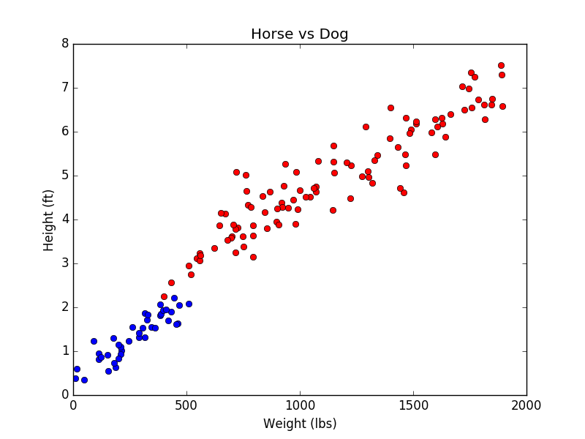
Is it a big dog or a small horse?
Red: Horse
Blue: Dog
New datapoint:
Is it a horse or a dog?
New datapoint:
Is it a horse or a dog?
New datapoint:
Is it a horse or a dog?
Notes:
Call on students to classify each point as it animates in. Force them to say the algorithm that they used in their head to classify the point. If they don’t give a precise algorithm, chastise them (jk, don’t chastise them), and then ask another student to say a precise algorithm that they used in their head (for a new point, perhaps).
import numpy as np
import numpy.random
import scipy as sp
import pandas as pd
import matplotlib as mpl
import matplotlib.pyplot as plt
horse_weight = numpy.random.rand(100) * 1500.0 + 400.0 # lbs
horse_height = horse_weight/370 + numpy.random.normal(0, 0.5, horse_weight.shape) + 2 # ft
dog_weight = numpy.random.rand(40) * 500.0 + 10.0 # lbs
dog_height = dog_weight/300 + numpy.random.normal(0, 0.3, dog_weight.shape) + 0.5 # ft
plt.plot(horse_weight, horse_height, 'ro')
plt.plot(dog_weight, dog_height, 'bo')
plt.title("Horse vs Dog")
plt.xlabel("Weight (lbs)")
plt.ylabel("Height (ft)")
plt.show()

Slide 3
The k-Nearest Neighbors algorithm:
Training algorithm:
Store all the data… that’s all.
Prediction algorithm (predict the class of a new point x’):
Calculate the distance from x’ to all points in your dataset.
Sort the points in your dataset by increasing distance from x’.
Predict the majority label of the k closest points.
What is k?
Notes:
Note, the prediction computation time can grow large as the dataset size grows large. How does that compare to lin. reg?
import numpy as np
import numpy.random
import scipy as sp
import pandas as pd
import matplotlib as mpl
import matplotlib.pyplot as plt
from matplotlib.colors import ListedColormap
from sklearn import neighbors, datasets
from sklearn.preprocessing import StandardScaler
from sklearn.pipeline import make_pipeline
k = 1
hx = 0.5 # step size in the mesh
hy = 0.05
cmap_light = ListedColormap(['#FFAAAA', '#AAFFAA', '#AAAAFF'])
cmap_bold = ListedColormap(['#FF0000', '#00FF00', '#0000FF'])
numpy.random.seed(12345)
horse_weight = numpy.random.rand(50) * 1500.0 + 400.0 # lbs
horse_height = horse_weight/370 + numpy.random.normal(0, 0.5, horse_weight.shape) + 2 # ft
dog_weight = numpy.random.rand(30) * 800.0 + 10.0 # lbs
dog_height = dog_weight/300 + numpy.random.normal(0, 0.5, dog_weight.shape) + 1 # ft
X = np.column_stack((np.concatenate((horse_weight, dog_weight)),
np.concatenate((horse_height, dog_height))))
y = np.concatenate((np.zeros(horse_weight.shape),
np.ones(dog_weight.shape)))
clf = neighbors.KNeighborsClassifier(n_neighbors=k, weights='uniform')
clf = make_pipeline(StandardScaler(), clf)
clf.fit(X, y)
x_min, x_max = X[:, 0].min() - 1, X[:, 0].max() + 1
y_min, y_max = X[:, 1].min() - 1, X[:, 1].max() + 1
xx, yy = np.meshgrid(np.arange(x_min, x_max, hx),
np.arange(y_min, y_max, hy))
Z = clf.predict(np.c_[xx.ravel(), yy.ravel()])
Z = Z.reshape(xx.shape)
plt.figure()
plt.pcolormesh(xx, yy, Z, cmap=cmap_light)
plt.scatter(X[:, 0], X[:, 1], c=y, cmap=cmap_bold)
plt.xlim(xx.min(), xx.max())
plt.ylim(yy.min(), yy.max())
plt.title("Horse vs Dog")
plt.xlabel("Weight (lbs)")
plt.ylabel("Height (ft)")
plt.show()

Slide 4
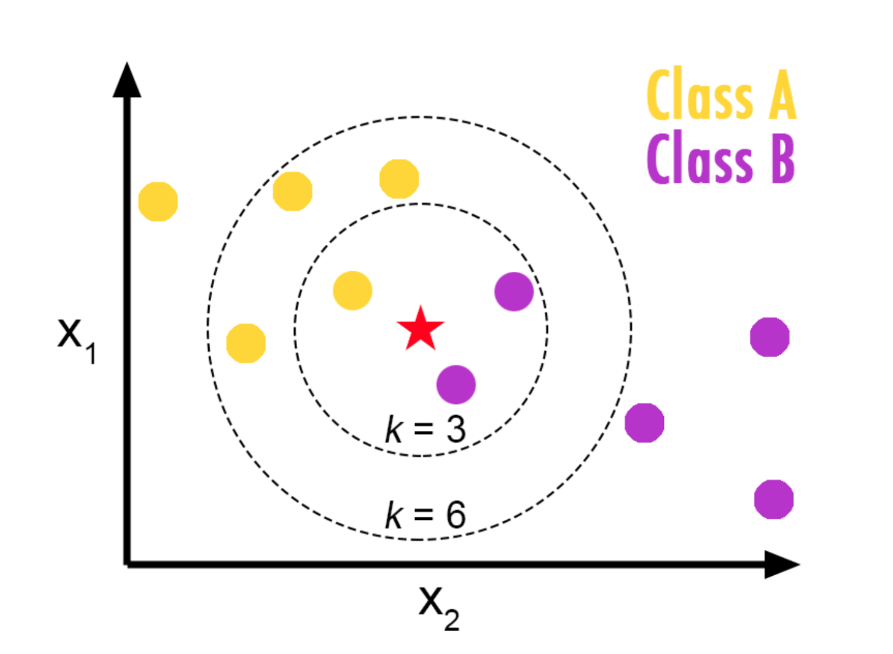

kNN: you pick k
What is the prediction for
when k=3?
What is the prediction for
when k=6?

Slide 5
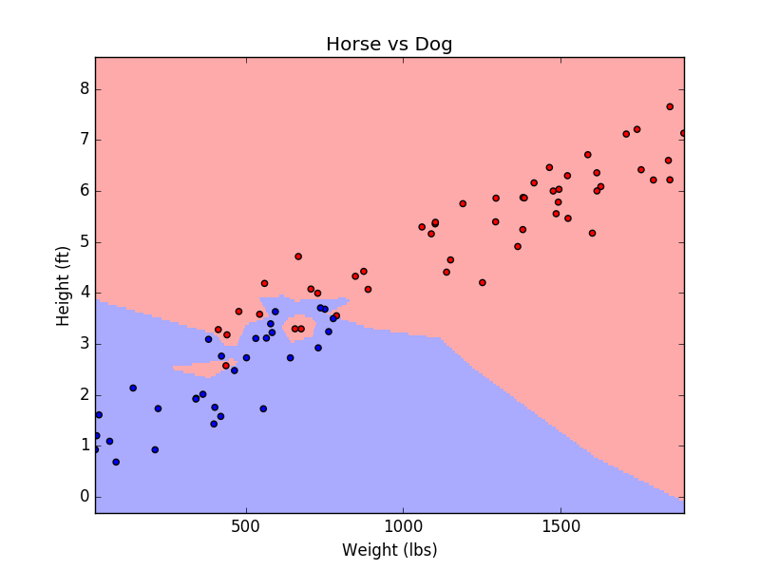
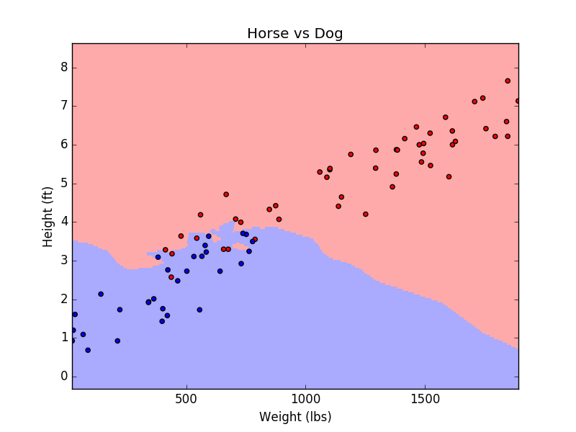
The only hyperparameter… k… the number of nearest neighbors to consider
k=1
k=5

Slide 6
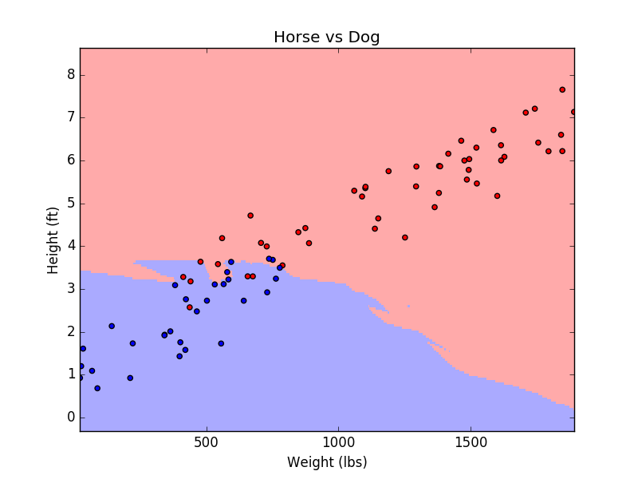
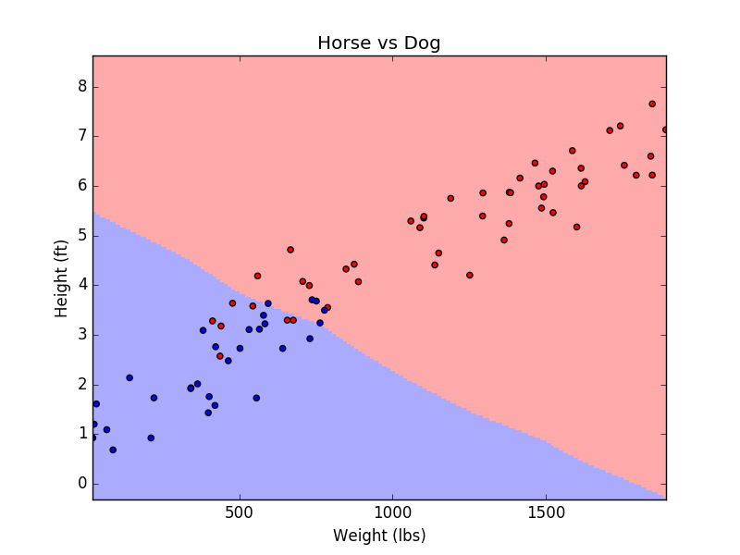
The only hyperparameter… k… the number of nearest neighbors to consider
k=10
k=50

Slide 7

Which model seems overfit?
k=1
k=50
As a general rule, start with:

Slide 8
What happens to model variance when k increases?
k=1
k=50

Slide 9
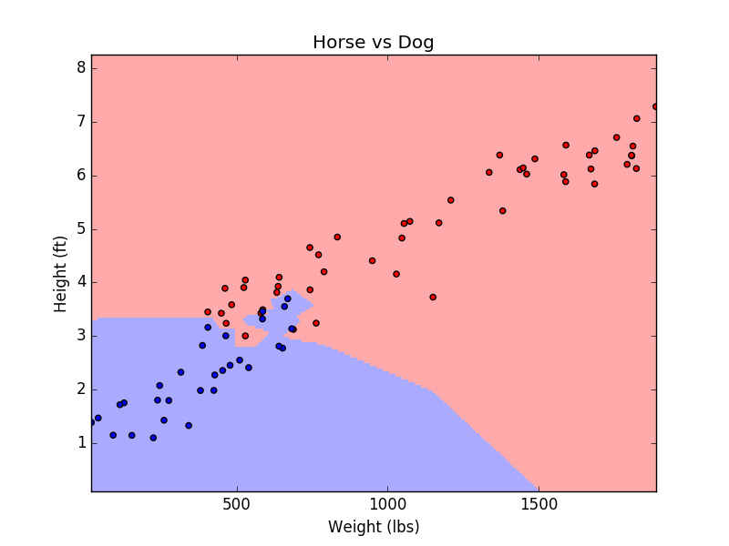
See the high variance?
Each dataset is randomly generated from the same population.
k=1
k=1

Slide 10
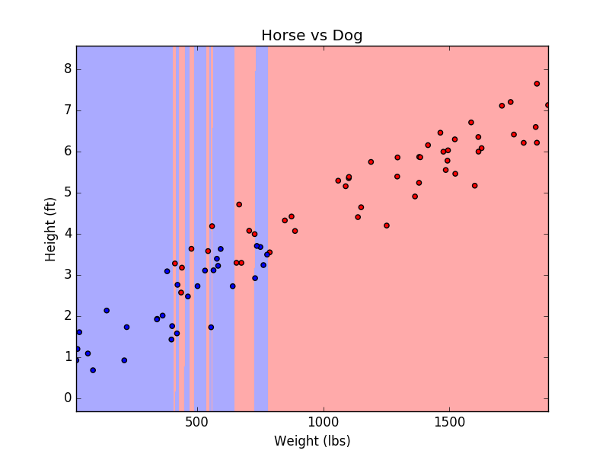
Be careful with the scale of your features!
k=1, scaled features
k=1, original-scale features
Speaking of distance… what distance metric are we using anyway?

Slide 11
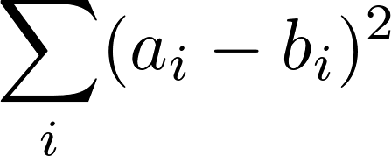
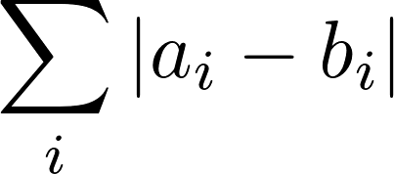
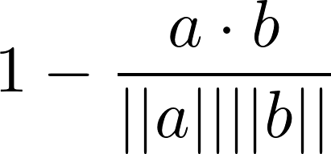
Distance Metrics
Euclidean Distance (L2):
Manhattan Distance (L1):
Cosine Distance = 1 - Cosine Similarity:

Slide 12


Point weighting (weighted voting)
Let the k nearest points have distances:
The i^{th} point votes with a weight of:
small distances are weighted more!
Notes:
Note: sklearn can do this for you if you want...

Slide 13

kNN for Regression
Let the k nearest points have distances:
t₂
t₆
Let the k nearest points have targets:
t₃
t₁
t₄
t₅
How can we do regression with kNN?
Predict the mean value of the k neighbors, or predict a weighted average.
Notes:
If student’s look like they are having fun, maybe have them help derive the weighted formula on the board...

Slide 14
kNN in high dimensions...
kNN is problematic when used with high dimensional (d) spaces… ... but it works pretty well (in general) for d<5
The nearest neighbors can be very “far” away in high dimensions…
Say you want to use a neighborhood of 10% (i.e. k = 0.1*n)
Let’s see how this looks as we increase the dimensionality… (next slide)

Slide 15
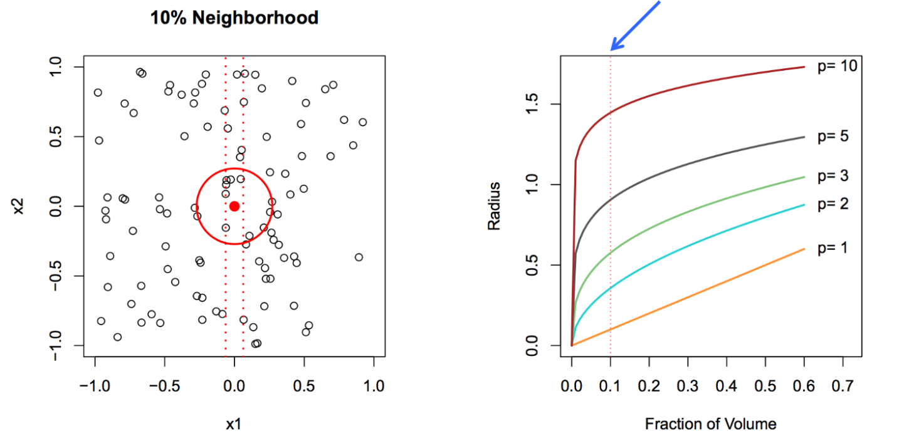
The Curse of Dimensionality
p = dimensionality
When p=1, we are only considering x1. When p=2, we are considering x1 and x2.
Notice the required radius in 2D is much larger than the required radius in 1D.
As we increase the dimensionality, we lose the concept of locality.
Notes:
The curse of dimensionality, put most simply (but perhaps most vaguely), goes like this: points tend to be “far” away in high dimension which means most datasets are sparse in high dimensions.

Slide 16

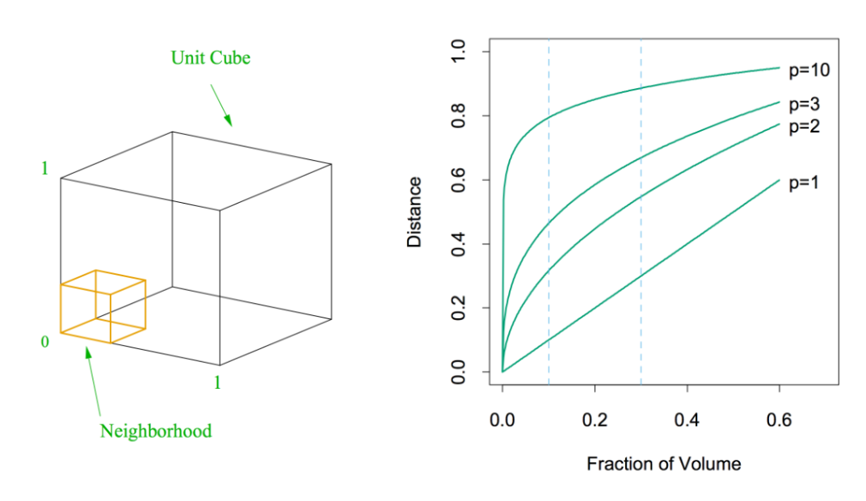
The Curse of Dimensionality (another perspective)
p = dimensionality
Say we have a unit (hyper)cube.
We want to create another
(hyper)cube inside the outer cube so that we fill X% of the outer cube.
(e)
How long must the edges of the inner cube be?
(f)
Notes:
Technically… a cube in more than 3 dims is called a hypercube.
e = f^{1/p}

Slide 17
The Curse of Dimensionality (another perspective)
Say you have a dataset with 100 samples, each with only one predictor.
But, one predictor doesn’t tell you enough, so you collect a new dataset, and this time you measure 10 predictors for each sample.
How many samples do you need in your new (10 predictor) dataset to achieve the same “sample density” as you originally had (in the one-predictor dataset)?
Just 100^10, that not that many… just
100,000,000,000,000,000,000

Slide 18
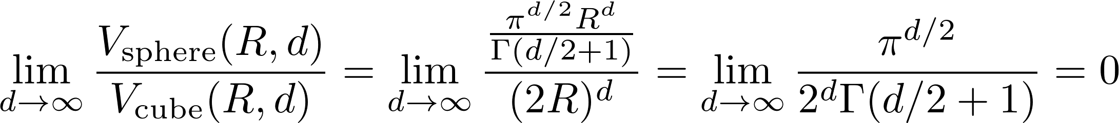
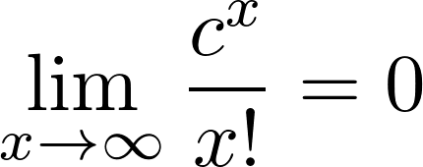
The Curse of Dimensionality (another perspective)
Don’t freak out...
Factorial overtakes exponentiation in the limit…
e.g.
Euler’s gamma function… basically, it’s the factorial function that can operate on fractional numbers
What does this mean?
Notes:
The ratio of the volume of a hypersphere to the volume of a hypercube goes to zero as the dimensionality goes to infinity. What!!??
Well, one way to explain this intuitively is to consider the the regions of the cube that are outside the sphere. In 2d, there are four such regions. In 3d, there are eight such regions. As d increases, the number of these regions increases exponentially. In high dimension, a sphere is quite pointy. From Wikipedia: “To put it another way, the high-dimensional unit hypercube can be said to consist almost entirely of the "corners" of the hypercube, with almost no "middle".”
https://en.wikipedia.org/wiki/Curse_of_dimensionality
https://en.wikipedia.org/wiki/Volume_of_an_n-ball
\lim_{d\to\infty} \frac{ V_{\text{sphere}} (R, d) }{ V_{\text{cube}} (R, d) } = \lim_{d\to\infty} \frac{ \frac{\pi^{d/2}R^d}{\Gamma(d/2 + 1)} }{ (2R)^d } = \lim_{d\to\infty} \frac{ \pi^{d/2} }{ 2^d \Gamma(d/2 + 1) } = 0
\lim_{x\to\infty} \frac{ c^x } { x! } = 0

Slide 19
The Curse of Dimensionality… takeaways
kNN (or any method that relies on distance metrics) will suffer in high dimensions.
Nearest neighbors are “far” away in high dimensions (even for d=10).
A 10% neighborhood in a high dimensional unit hypercube requires a hypersphere with large radius.
Hyperspheres are weird in high dimensions…
“They are super-pointy!” (Ryan’s interpretation)
High dimensional data tends to be sparse; it’s easy to overfit sparse data.
It takes A LOT OF DATA to make up for increased dimensionality.
Notes:
Btw, we’ll learn about dimensionality reduction methods in two weeks.

Slide 20
Parametric vs Non-parametric Models
Parametric models have a fixed number of parameters. - Logistic regression is parametric. - kNN is non-parametric.
Parametric models are more structured. The added structure often combats the curse of dimensionality... as long as the structure is derived from reasonable assumptions.
Alternate perspective: Parametric models are not distance based, so the curse doesn’t apply!
Notes:
Logistic regression: the beta coefficients, set ahead of time by the scientist
kNN: the decision complexity grows as the dataset grows

Slide 21
Summary: kNN
Pros:
super-simple
training is trivial (store the data)
works with any number of classes
easy to add more data
few hyperparameters:
k
distance metric
Cons:
high prediction cost (especially for large datasets)
high-dims = bad
we’ll learn dimensionality reduction methods in two weeks!
categorical features don’t work well…

Slide 22
Decision Trees
Decision Trees
Entropy
Information Gain
Recursion
How to build a tree
Ryan Henning

Slide 23
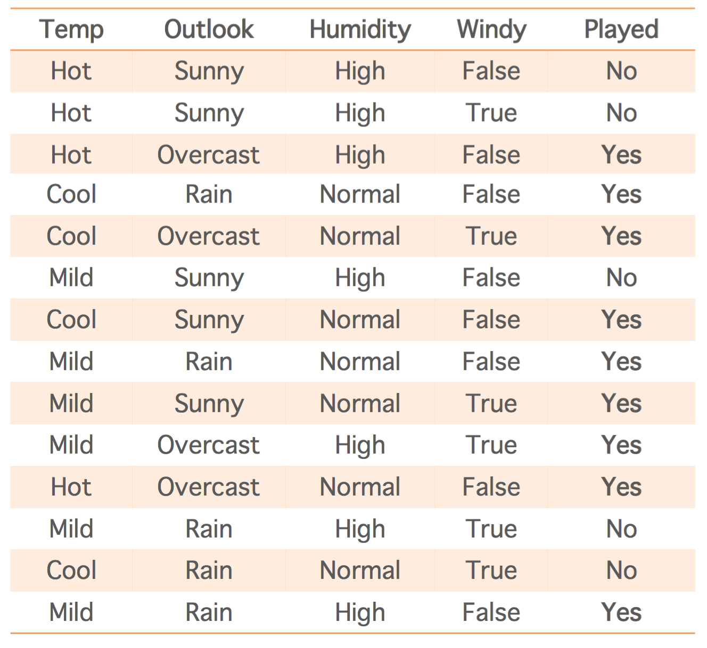
Historical log of times I played tennis:
def will_play(temp, outlook, humidity,\
windy): if outlook == 'sunny': if humidity == 'normal': return True else: # humidity == 'high' return False elif outlook == 'overcast': return True else: # outlook == 'rain' if windy == True: return False else: # windy == False: return True
Notes:
Before revealing the code, begin writing code on the board. Not this code. Write code like this on the board… wait for the students to think you’re serious before stopping. Maybe even say something like “you all sit tight, I think this will only take me like 20 minutes…”
if temp==’hot’ and outlook==’sunny’ and humidity==’high’ and windy==False:
return False
elif temp==’hot’ and outlook==’sunny’ and humidity==’high’ and windy==True:
return False
elif temp==’hot’ and outlook==’overcast’ and humidity==’high’ and windy==False:
return True
...

Slide 24
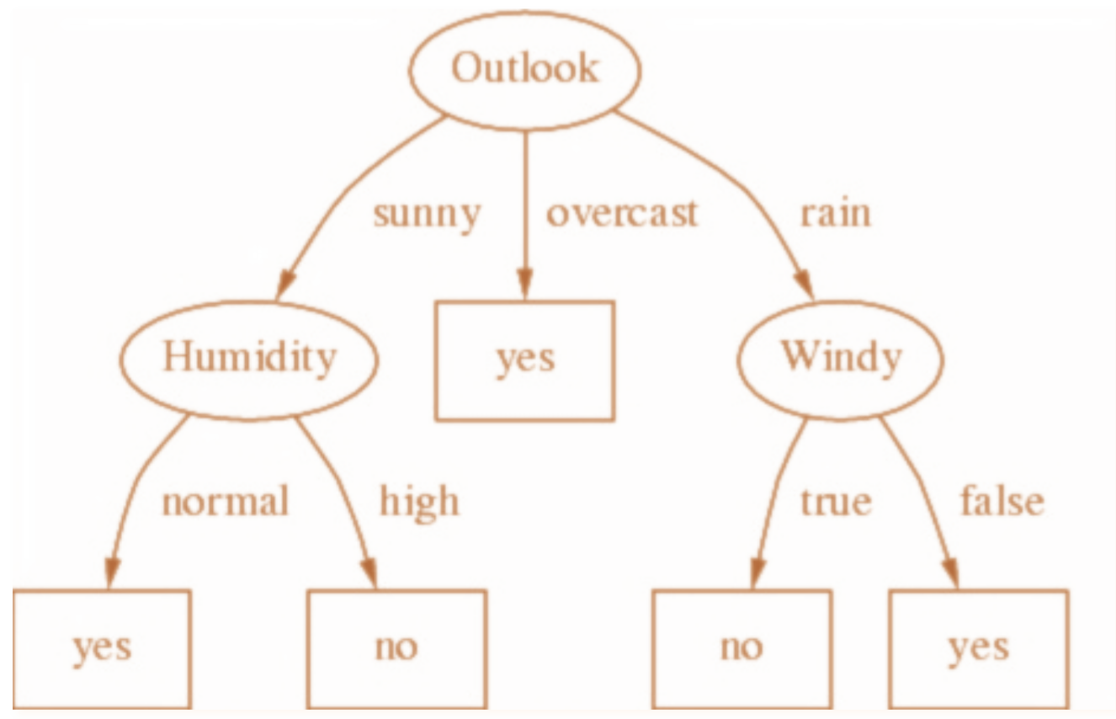
DON’T WRITE CODE LIKE THIS!!!! AHHH!!! #%#%#%@#%!#$^^*%&(%^&*$%^&#$%
def will_play(temp, outlook, humidity,\
windy): if outlook == 'sunny': if humidity == 'normal': return True else: # humidity == 'high' return False elif outlook == 'overcast': return True else: # outlook == 'rain' if windy == True: return False else: # windy == False: return True
Instead, let’s write an algorithm to build a Decision Tree for us, based on the training data we have.
Notes:
I would only write a slide title as obnoxious as this one in an extreme circumstance, mind you.
Hopefully this will motivate decision trees.
Mention, the tree is not hard coded, it is build dynamically from the training data. We just need an algorithm to know what to build, and then we need some data structures in code to represent the tree in memory!

Slide 25
Benefits of a decision tree:
Benefits:
non-parametric, non-linear
can be used for classification and for regression
real and/or categorical features
easy to interpret
computationally cheap prediction
handles missing values and outliers
can handle irrelevant features
Will I play tennis?

Slide 26
Drawbacks of Decision Trees
Drawbacks:
expensive to train
greedy algorithm (local maxima)
easily overfits
right-angle decision boundaries only
Will I play tennis?
But how can we build one of these from training data?
Notes:
I know you want to know how to build a decision tree. I know, I know. But we need to talk about entropy, information gain, and recursion first.

Slide 27

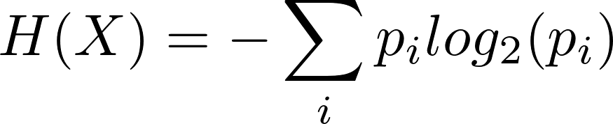
Entropy (a measure of information in an event stream)
Shannon Entropy
information content
of X
number of bits needed to encode each X event
discrete random
variable
probability of each possible discrete outcome
iterate over pmf
Notes:
I don’t really know anything about thermodynamics version of entropy. THIS entropy is from Claude Shannon’s information theory work. Anyone know how this connects to thermodynamics? Something about energy, heat, and the log of the number of microstates… anyway…
The information content is also sometimes called the “surprisal” of the event, as rare events are more surprising thus carry more information.
Note, to represent the number n in binary, you need ceil(log_2(n)) bits. So, log_2(1/P(X)) can be seen as the number of bits you need to represent an event that occurs with probability P(X). This equation gives a lower bound of the number of bits needed per event to encode a string of events that happen.
H(X) = E[I(X)] = E[log_2(\tfrac{1}{P(X)})]
= -E[log_2(P(X))]
H(X) = - \sum_i p_i log_2(p_i)
https://en.wikipedia.org/wiki/Entropy_(information_theory)
https://en.wikipedia.org/wiki/Self-information

Slide 28
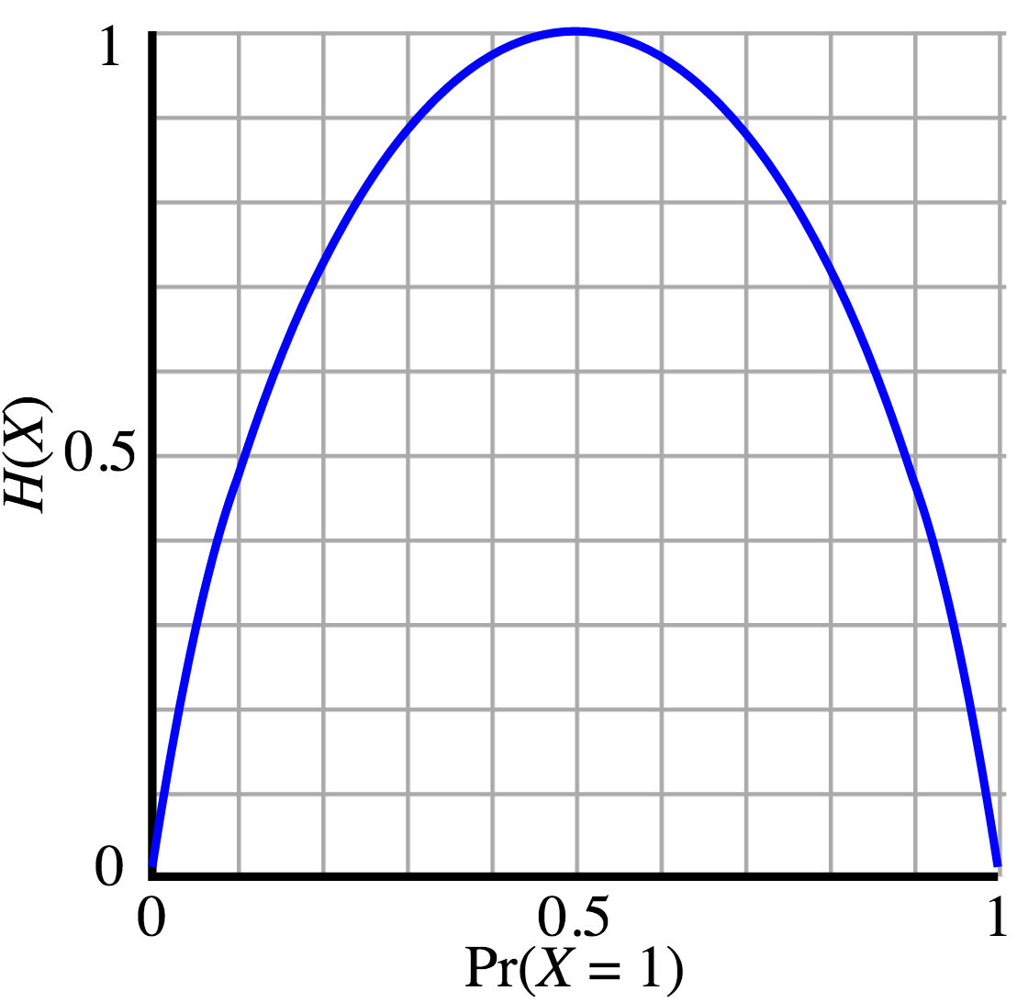
Entropy graph of a Bernoulli random variable X
Notes:
Graph:
By Brona and Alessio Damato Newer version by Rubber Duck (☮ • ✍) [GFDL (http://www.gnu.org/copyleft/fdl.html) or CC-BY-SA-3.0 (http://creativecommons.org/licenses/by-sa/3.0/)], via Wikimedia Commons

Slide 29
Shannon Entropy Diversity Index (aka, the Shannon Index)
We can measure the diversity of a set using Shannon Entropy (H) if we interpret the frequency of elements in the set as probabilities.
Estimate:
P( ) = 3/12 = 0.25
P( ) = 4/12 = 0.33
P( ) = 5/12 = 0.42
__________
H = 1.55
Notes:
https://en.wikipedia.org/wiki/Diversity_index
http://www.shannonentropy.netmark.pl/

Slide 30
One level in a decision tree:
This is a node somewhere in our decision tree. It doesn’t matter where. We will call this node the “parent” node.
Entropy of the parent?
H(parent) = 1.55
Entropy of the children?
H(child_1) = 0.97
H(child_2) = 0.985
Our goal is to split these examples into two new sets. We will use a single feature (we can choose which one) as the spitting condition.
False
True
has_ ?
Here’s the result of one possible way to split. We call these new nodes the “child” nodes.
Notes:
Circle, heart, and smile are TARGETS. Features are shown as adornments atop each example. The two types of features are has_yellow_diamond and has_pink_diamond.

Slide 31
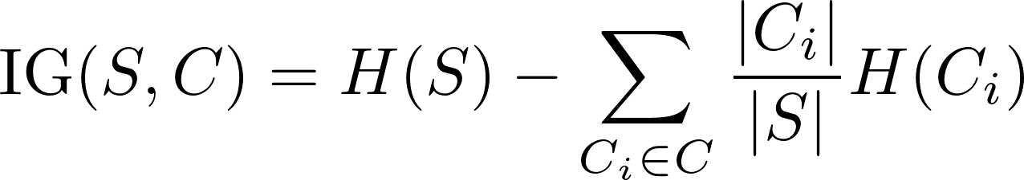
Information Gain (using Shannon Entropy Diversity Index)
Information gain
from this split
the set of children
False
True
has_ ?
the parent’s set of examples
the set of examples in each child
Notes:
\text{IG}(S, C) = H(S) - \sum_{C_i \in C} \frac{|C_i|}{|S|} H(C_i)

Slide 32
Information Gain
Information Gain = 0.57
False
True
has_ ?

Slide 33
Information Gain
Information Gain = 0.765
False
MORE THAN THE LAST SPLIT. THIS IS GOOD!
True
has_ ?
Notes:
H(left child) = 0.65
H(right child) = 0.92

Slide 34
Splitting Algorithm:
Possible Splits:
Consider all binary splits based on a single feature:
if the feature is categorical, split on value or not value.
if the feature is numeric, split at a threshold: >threshold or <=threshold
Splitting Algorithm:
1. Calculate the information gain for all possible splits.
2. Commit to the split that has the highest information gain.

Slide 35
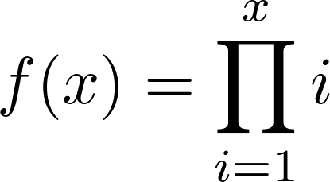
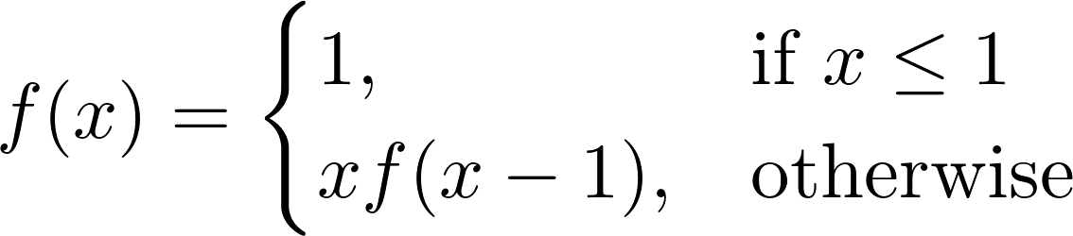
Recursion
def f(x): ''' This function returns x!. >>> f(5) 120 ''' if x <= 1: return 1 else: return x * f(x-1) if __name__ == '__main__': import doctest doctest.testmod()
What is this function?
Is this an equivalent function?
Notes:
Recursion is when a function calls itself. Tell them about the term (and reason) “base case”.
Show them the easter egg on google (search “recursion”, you’ll see).

Slide 36
How to build a decision tree (pseudocode):
function BuildTree: If every item in the dataset is in the same class or there is no feature left to split the data: return a leaf node with the class label Else: find the best feature and value to split the data split the dataset create a node for each split call BuildTree and add the result as a child of the node return node
Notes:
Point out the base case. Point out the recursive call. Rather, ask the students for these.

Slide 37
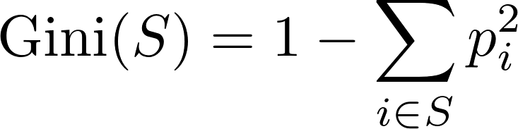
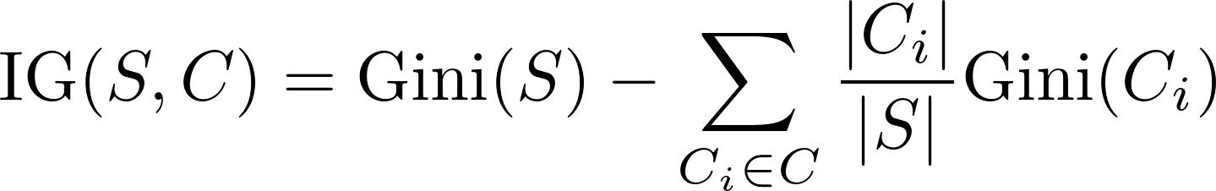
The Gini Index
A measure of impurity: the probability of a misclassification if a random sample drawn from the set is classified according to the distribution of classes in the set
Scikit-learn doesn’t use Shannon Entropy Diversity by default. It uses the Gini Index:
Information gain using the Gini Index:
Notes:
\text{Gini}(S) = 1 - \sum_{i \in S} p_i^2
\text{IG}(S, C) = \text{Gini}(S) - \sum_{C_i \in C} \frac{|C_i|}{|S|} \text{Gini}(C_i)

Slide 38
Regression Trees
Targets are real values… so… now we can’t use Information Gain or Gini Index for splitting! What do we do?
Use variance! Cool, now we can train.
How do we predict?
Either predict the mean value of the leaf, or do linear regression within the leaf!
Notes:
Using linear regression inside a leaf is called a “model tree”

Slide 39
Pruning
Overfitting is likely if you build your tree all the way until every leaf is pure.
Prepruning ideas (prune while you build the tree):
leaf size: stop splitting when #examples gets small enough
depth: stop splitting at a certain depth
purity: stop splitting if enough of the examples are the same class
gain threshold: stop splitting when the information gain becomes too small
Postpruning ideas (prune after you’ve finished building the tree):
merge leaves if doing so decreases test-set error
(see pair.md for details)

Slide 40
Algorithm Names:
The details of training a decision tree vary… each specific algorithm has a name. Here are a few you’ll often see:
ID3: category features only, information gain, multi-way splits, ...
C4.5: continuous and categorical features, information gain, missing data okay, pruning, ...
CART: continuous and categorical features and targets, gini index, binary splits only, …
...

